Slide 1
Covering Campaign Finance With Data
Sean McMinn
Github.com/shmcminn/xyz

Slide 2
Data stories?

Slide 3
Steps to a data story
Find data
Clean data
Analyze data
Present data

Slide 4
Agenda
Guest: Michael Beckel, Issue One
FEC data
Lobbying data
Financial disclosure data

Slide 5
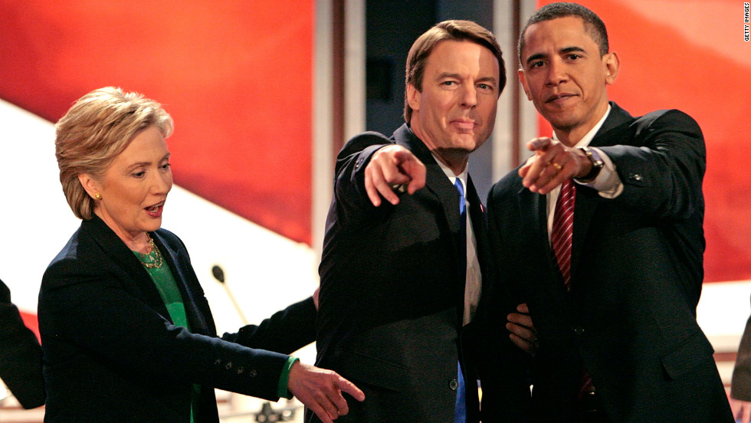
Crooks and Campaign Finance
Recognize this guy?

Slide 6
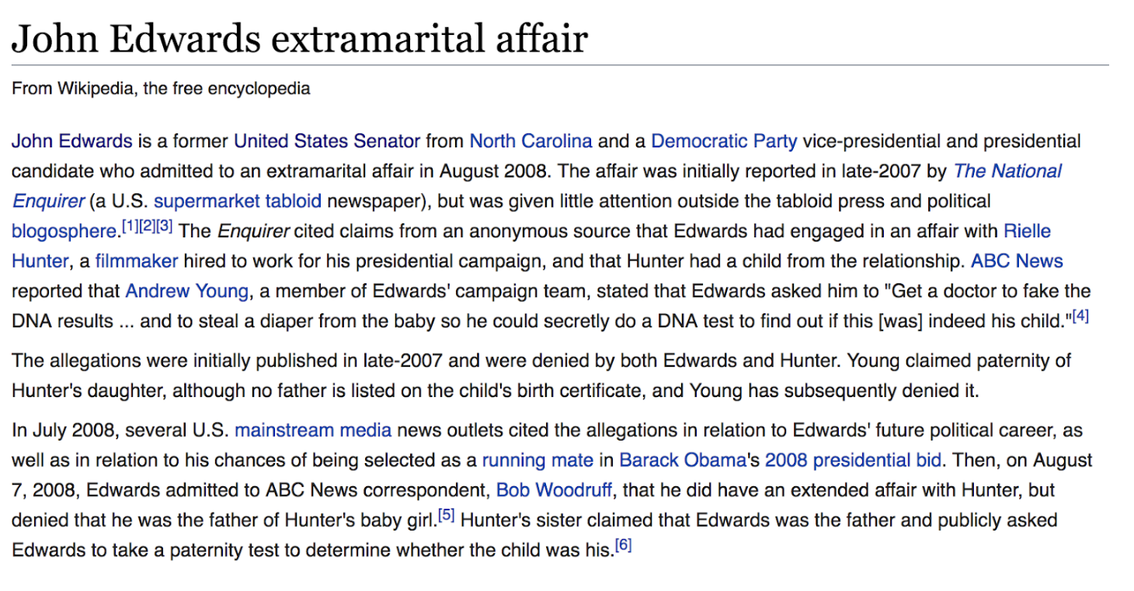
Crooks and Campaign Finance

Slide 7
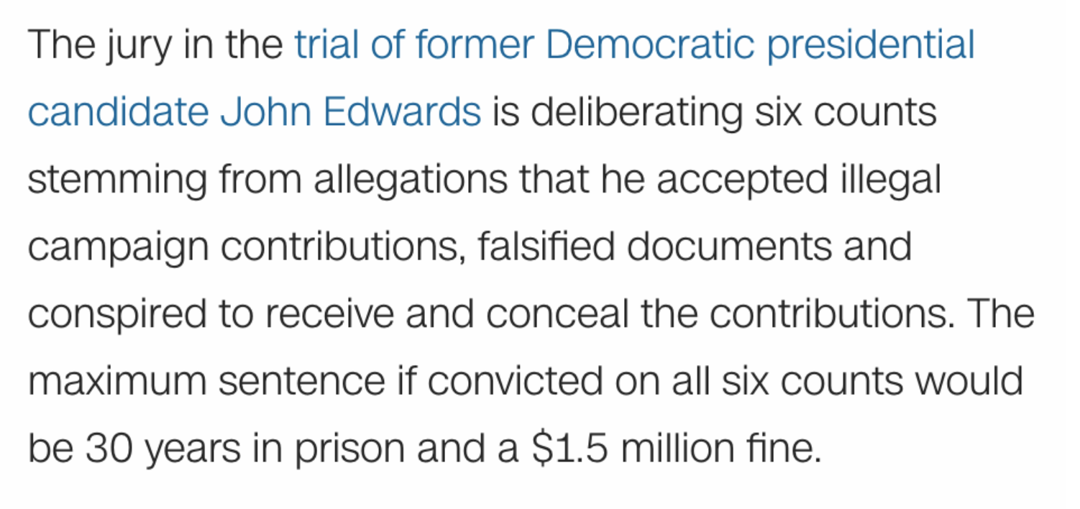
Crooks and Campaign Finance
Notes:
Rich heiress allegedly gave hundreds of thousands through the aide who claimed to be the father -- from CNN: http://www.cnn.com/2012/05/23/justice/north-carolina-edwards-charges/index.html

Slide 8
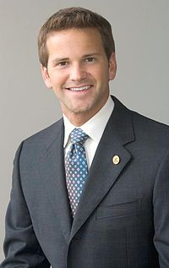
Crooks and Campaign Finance
Recognize this guy?

Slide 9
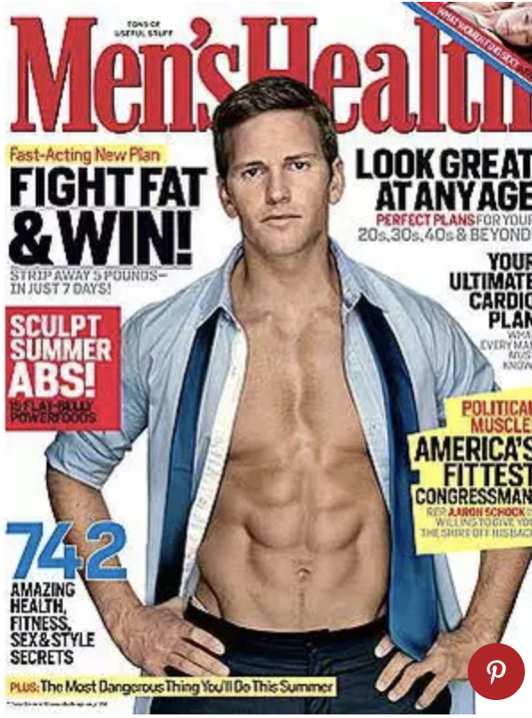
Crooks and Campaign Finance
Does this help?

Slide 10
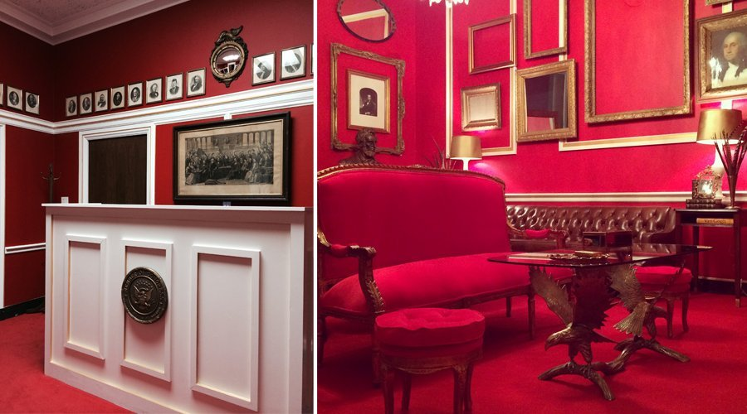
Crooks and Campaign Finance
He liked Downton Abbey … a lot.

Slide 11
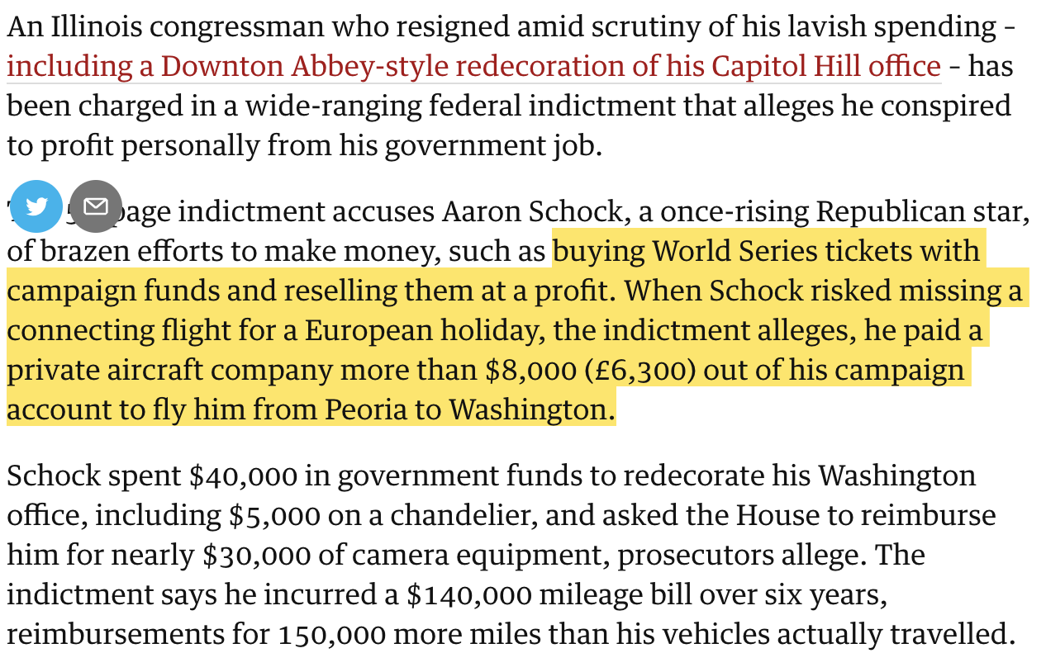
Crooks and Campaign Finance
Notes:
This was at the end of 2016 … Trial set for next January

Slide 12
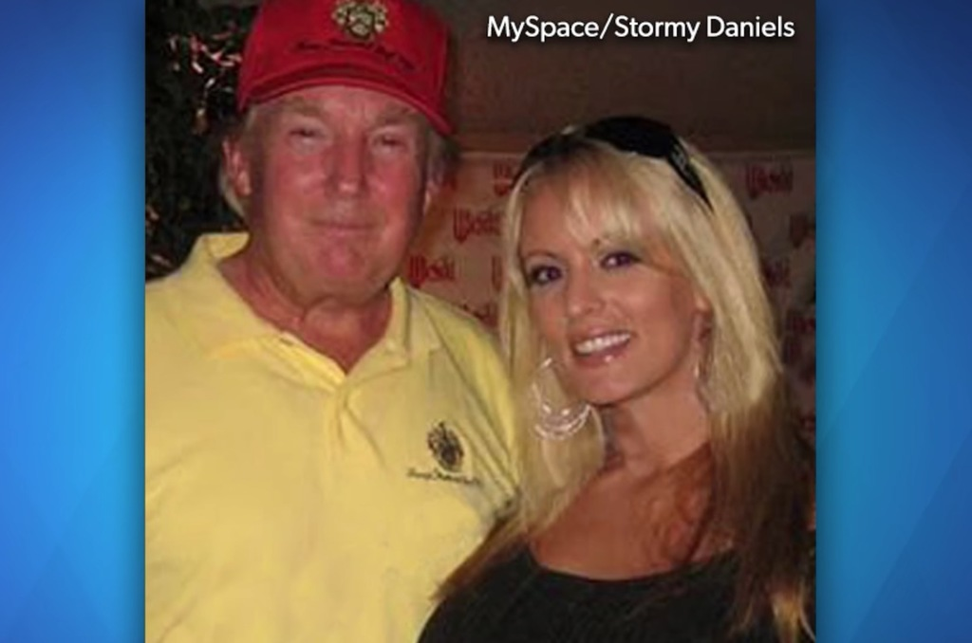
Crooks and Campaign Finance
Recognize this pair?

Slide 13
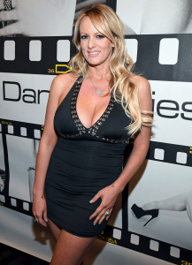


Crooks and Campaign Finance

Slide 14
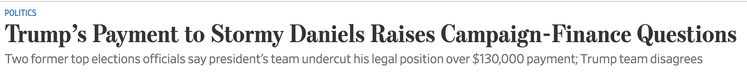
Crooks and Campaign Finance

Slide 15
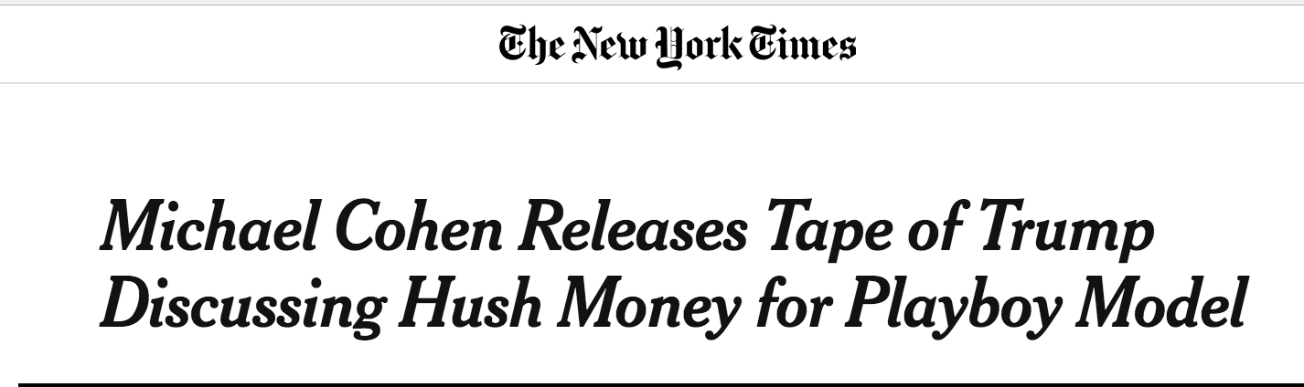
Crooks and Campaign Finance

Slide 16
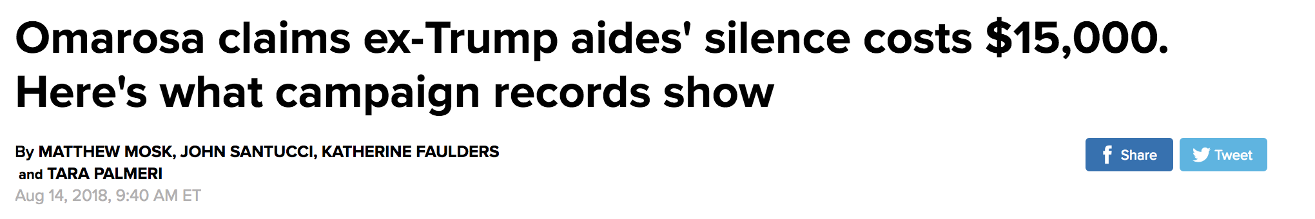
Crooks and Campaign Finance
And fresh off the presses!

Slide 17
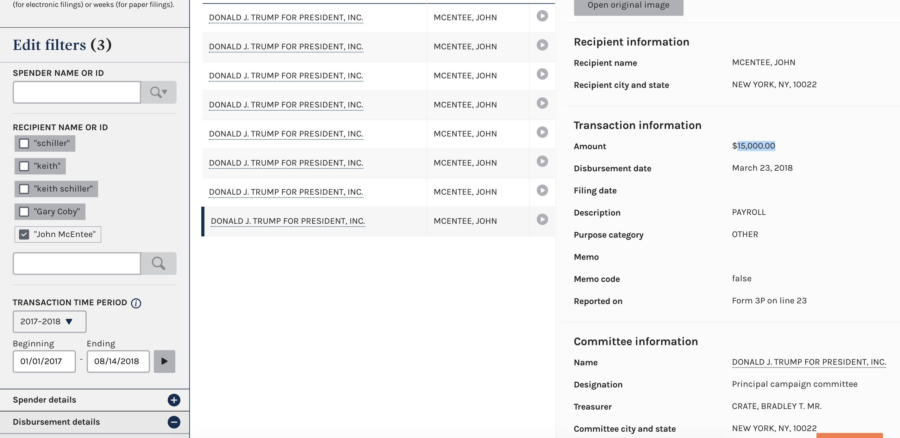
Crooks and Campaign Finance
And fresh off the presses!

Slide 18
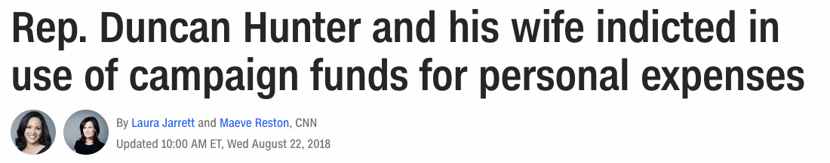
Crooks and Campaign Finance
And fresh off the presses!

Slide 19
Campaign Finance
All campaign contributions over $200 must be itemized and reported by the committee that receives them
All campaign expenditures must be itemized and reported by the committee

Slide 20
Campaign Finance
Rachel Shorey: Three general types of camp fin stories:
Horserace stories: Which candidate is winning the money race?
Donor stories: Who is giving money (and why)?
Legal analysis stories: How are candidates working creatively inside (or outside) the law?

Slide 21
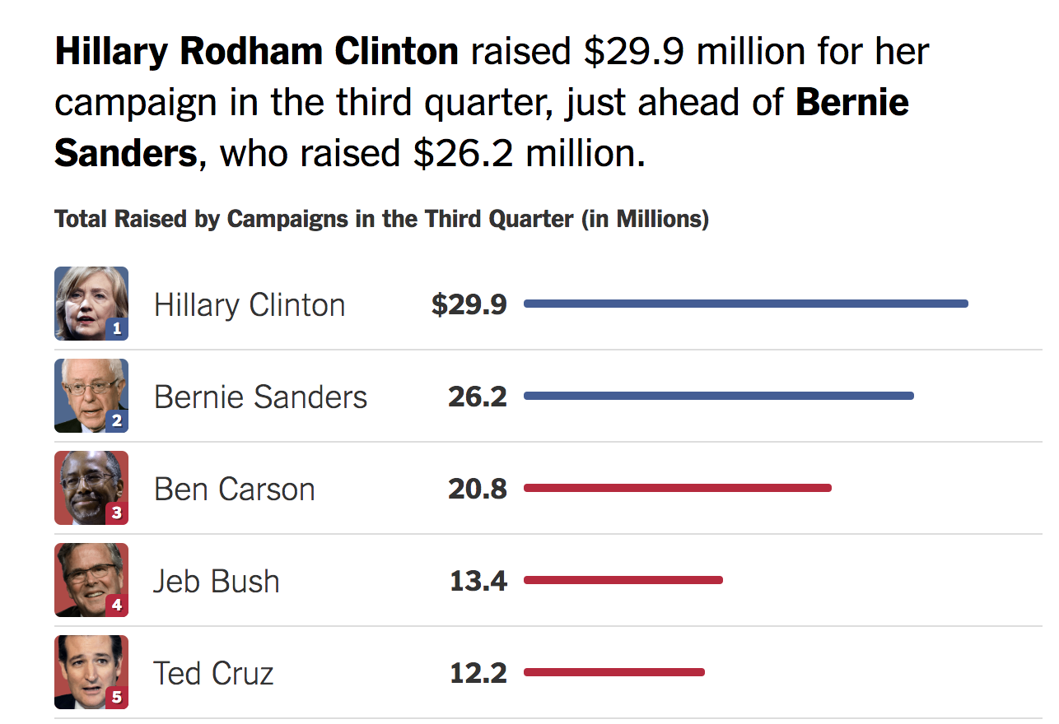
Campaign Finance

Slide 22
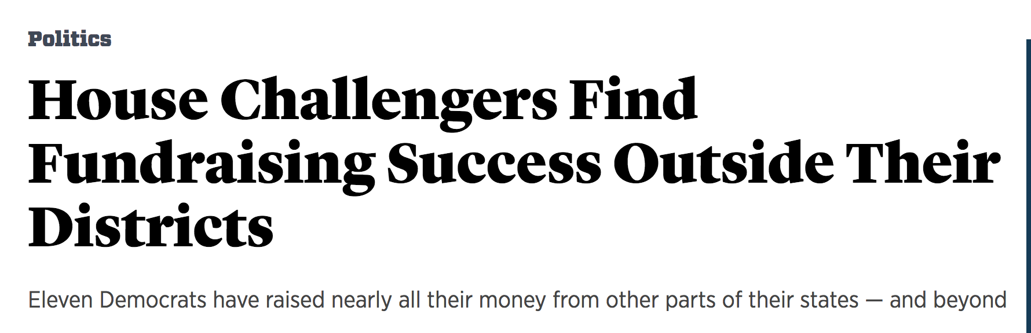
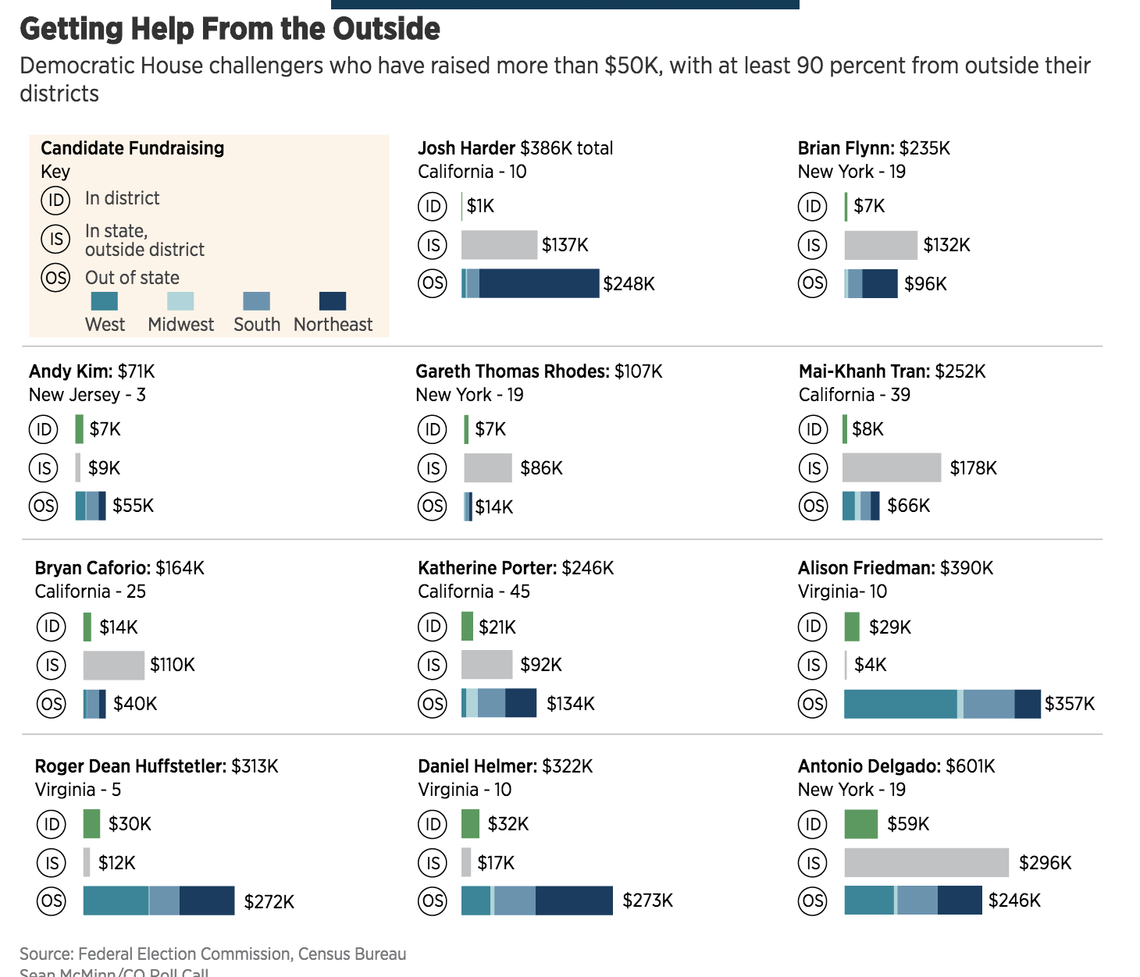
Campaign Finance

Slide 23
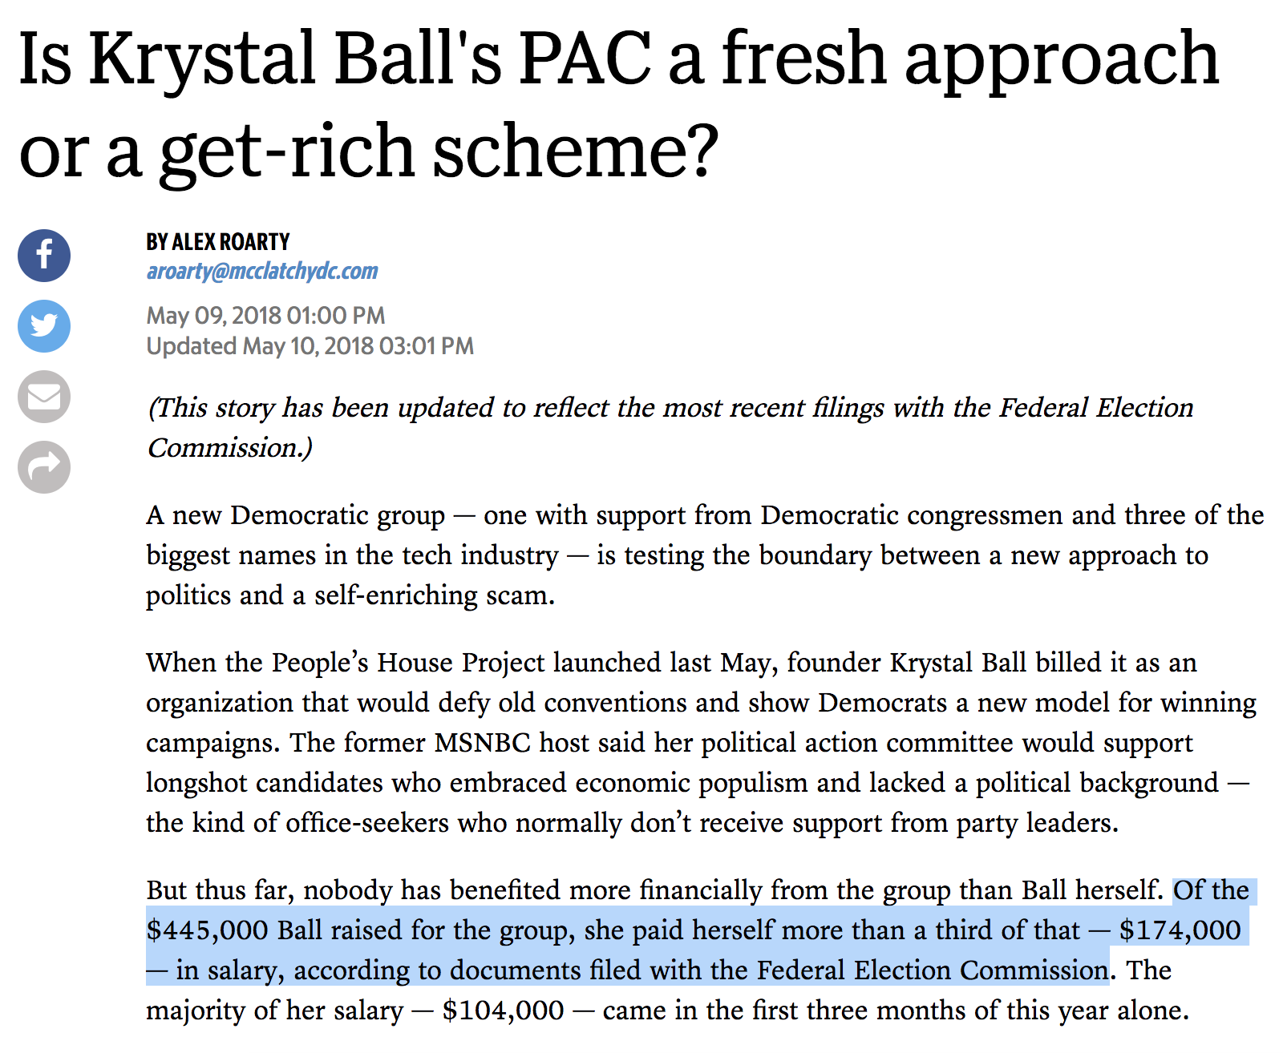
Campaign Finance

Slide 24
Campaign Finance
To touch on PACs:
Anyone can set up their own committee to help a campaign
BUT there’s limitations on how much you can spend
The answer? Super PACs
http://www.cc.com/video-clips/yzb7q2/the-colbert-report-colbert-super-pac---trevor-potter

Slide 25
Campaign Finance
How can reporters find these stories?
FEC.gov – your best friend for federal campaign finance
Notes:
Look up: Spielberg, Northwestern president, Trump Northwestern donations, Clinton Northwestern donations

Slide 26
Campaign Finance
Pitfalls
Amendments
Refunds
$200 caveat – small vs big donors
Generally good to check your analysis by someone who’s done this before

Slide 27
Other Resources
Open Secrets (CRP) (categorized and tagged data by industry, etc)
Opensecrets.org
Propublica FEC Itemizer (easy to search)https://projects.propublica.org/itemizer/

